Slide 1
Numerical Solution of Ordinary Differential Equations (ODE): Boundary Value Problem (BVP)
Lecture-3

Slide 2
Specific Aims
Applications
Introduction of Boundary value problem (BVP)
Discuss finite difference method
Examples of the solution of BVP by using finite difference method
Multiple questions
Exercises

Slide 3
Applications
Science and Engineering
Introduction of BVP
Problems involving second and higher order differential equations, we may prescribed the conditions at two or more points. Such problems are called boundary value problems (BVP).
Finite Difference Formula
Forward difference formula
Backward difference formula
Central difference formula

Slide 4
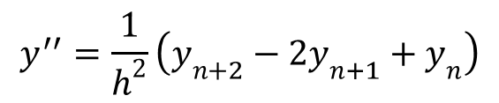
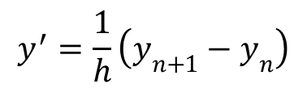
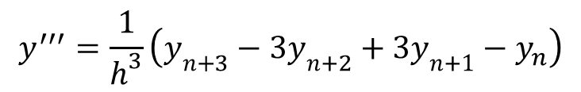
Forward difference formula
$$y^{′}=\frac{1}{h}\left(y_{n+1}−y_{n}\right)$$
For first order
$$y^{′′}=\frac{1}{h^{2}}\left(y_{n+2}−2y_{n+1}+y_{n}\right)$$
For second order
$$y^{′′′}=\frac{1}{h^{3}}\left(y_{n+3}−3y_{n+2}+3y_{n+1}−y_{n}\right)$$
For third order

Slide 5
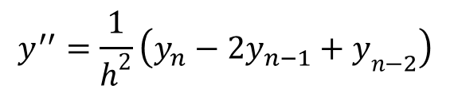
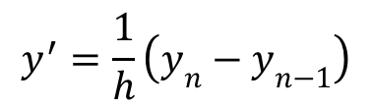
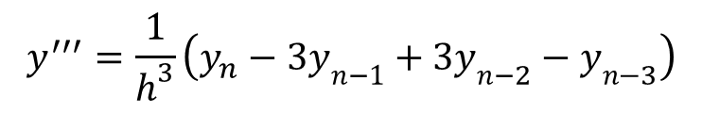
Backward difference formulas:
$$y^{′}=\frac{1}{h}\left(y_{n}−y_{n−1}\right)$$
For first order
$$y^{′′}=\frac{1}{h^{2}}\left(y_{n}−{2y}_{n−1}+y_{n−2}\right)$$
For second order
$$y^{′′′}=\frac{1}{h^{3}}\left(y_{n}−3y_{n−1}+3y_{n−2}−y_{n−3}\right)$$
For third order

Slide 6
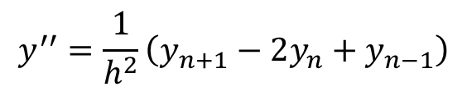
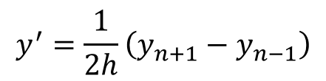
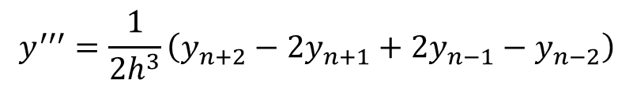
Central Difference formula
$$y^{′}=\frac{1}{2h}\left(y_{n+1}−y_{n−1}\right)$$
For first order
For second order
$$y^{′′}=\frac{1}{h^{2}}\left(y_{n+1}−2y_{n}+y_{n−1}\right)$$
For third order
$$y^{′′′}=\frac{1}{{2h}^{3}}\left(y_{n+2}−2y_{n+1}+{2y}_{n−1}−y_{n−2}\right)$$

Slide 7
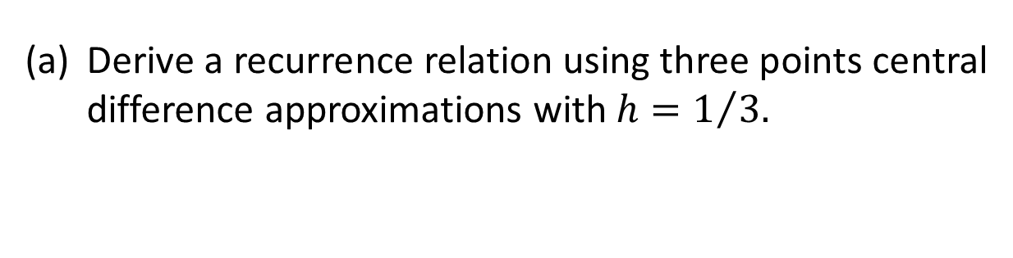
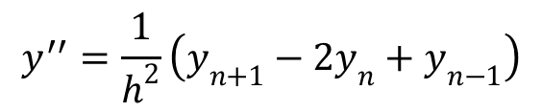
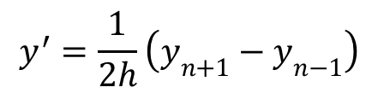
Examples
Question 1#:
Consider the boundary value problem
$$y^{′′}−y^{′}=1, y\left(0\right)=1, y(1)=2\left(e−1\right)$$
Derive a recurrence relation using three points central difference approximations with $h=1/{3.}$
(b) Using the above finite difference formula solve the
above BVP.
Solution:
Using central difference formulas, we have
$$y^{′}=\frac{1}{2h}\left(y_{n+1}−y_{n−1}\right)$$
$$y^{′′}=\frac{1}{h^{2}}\left(y_{n+1}−2y_{n}+y_{n−1}\right)$$

Slide 8
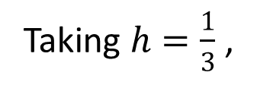
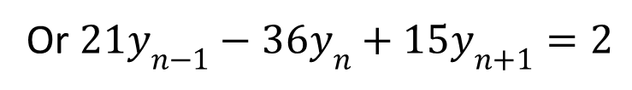

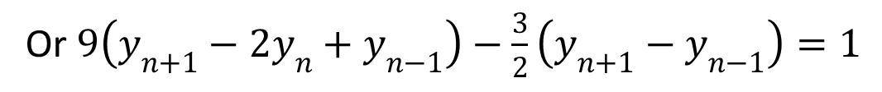
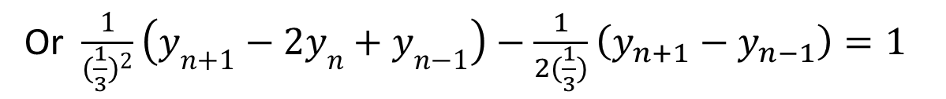
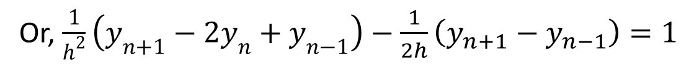
Given ODE is
$$y^{′′}−y^{′}=1$$
Or, $\frac{1}{h^{2}}\left(y_{n+1}−2y_{n}+y_{n−1}\right)−\frac{1}{2h}\left(y_{n+1}−y_{n−1}\right)=1$
Taking $h=\frac{1}{3}$ ,
Or $\frac{1}{{(\frac{1}{3})}^{2}}\left(y_{n+1}−2y_{n}+y_{n−1}\right)−\frac{1}{2(\frac{1}{3})}\left(y_{n+1}−y_{n−1}\right)=1$
Or $9\left(y_{n+1}−2y_{n}+y_{n−1}\right)−\frac{3}{2}\left(y_{n+1}−y_{n−1}\right)=1$
Or $21y_{n−1}−36y_{n}+15y_{n+1}=2$

Slide 9

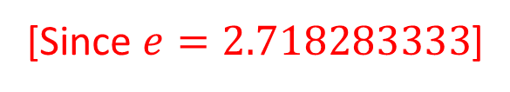
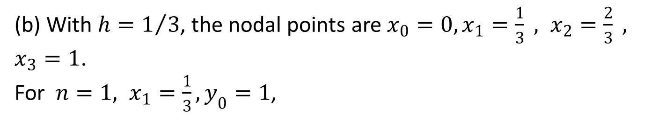
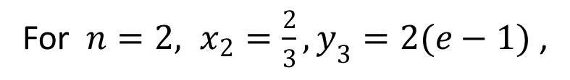

$21y_{n−1}−36y_{n}+15y_{n+1}=2$
(b) With $h=1/3$, the nodal points are $x_{0}=0, x_{1}=\frac{1}{3} , x_{2}=\frac{2}{3} , x_{3}=1$.
For $n=1, x_{1}=\frac{1}{3}, y_{0}=1$,
$$−36y_{1}+15y_{2}=2−21=−19, (1)$$
For $n=2, x_{2}=\frac{2}{3}, y_{3}=2(e−1)$ ,
$$21y_{1}−36y_{2}=2−30(e−1)=−49.5485, (2)$$
[Since $e=2.718283333$]
Solving the equations (1) and (2), we have
$$y_{1}=1.4548 and{ y}_{2}=2.2250$$

Slide 10
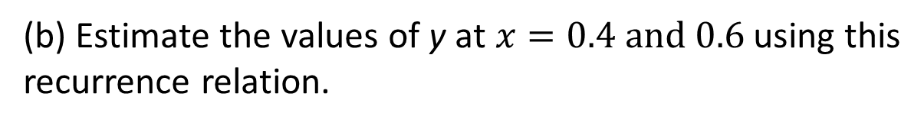
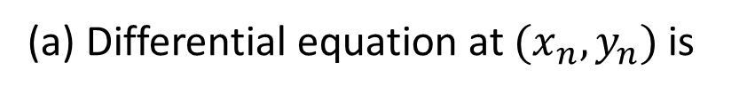

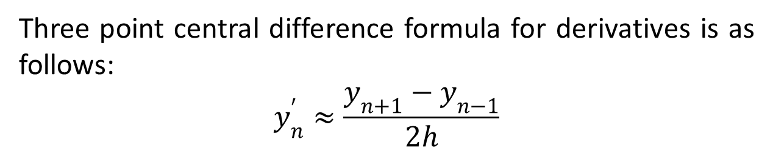
Question 2#:
Given that $y^{′}=2xy^{2}−y$, where $y=1 at x=0$.
(a) Use three point central difference formula for derivative to derive a recurrence relation for the above IVP.
(b) Estimate the values of y at $x=0.4 and 0.6$ using this recurrence relation.
Solution:
(a) Differential equation at $(x_{n}, y_{n})$ is
$${y′}_{n}=2x_{n}y_{n}^{2}−y_{n}$$
Three point central difference formula for derivatives is as follows:
$$y_{n}^{′}≈\frac{y_{n+1}−y_{n−1}}{2h}$$

Slide 11
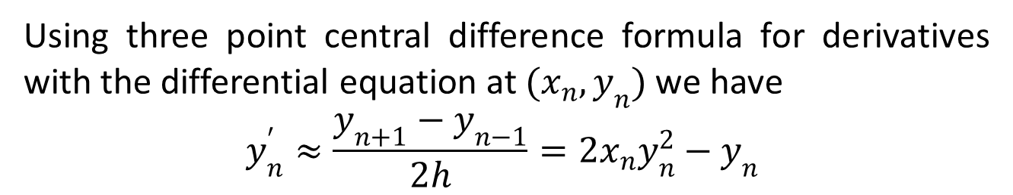
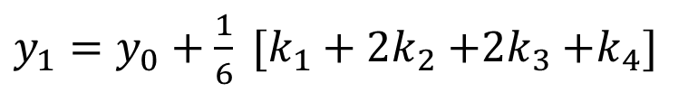
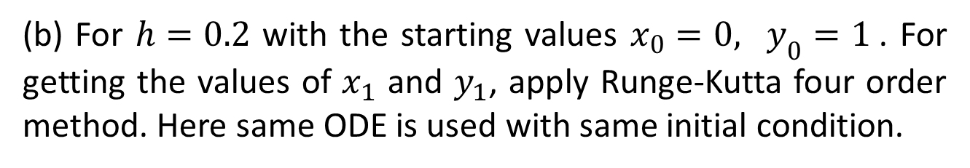
Using three point central difference formula for derivatives with the differential equation at $(x_{n}, y_{n})$ we have
$$y_{n}^{′}≈\frac{y_{n+1}−y_{n−1}}{2h}=2x_{n}y_{n}^{2}−y_{n}$$
$$y_{n+1}=y_{n−1}+2h\left(2x_{n}y_{n}^{2}−y_{n}\right)$$
(b) For $h=0.2$ with the starting values $x_{0}=0, y_{0}=1$. For getting the values of $x_{1}$ and $y_{1}$, apply Runge-Kutta four order method. Here same ODE is used with same initial condition.
The formula of second order Runge-Kutta method:
$y_{1}=y_{0}+\frac{1}{6} [k_{1}+2k_{2}{+2k}_{3}{+k}_{4}]$

Slide 12

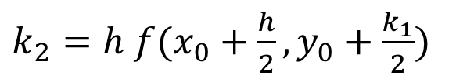


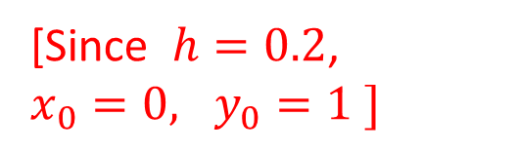

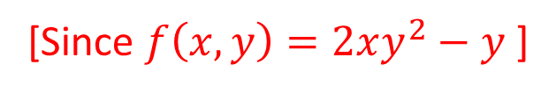
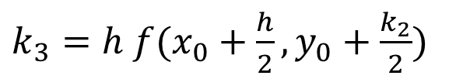

where
$k_{1}=h f(x_{0}, y_{0})$
$k_{2}=h f(x_{0}+\frac{h}{2}, y_{0}+\frac{k_{1}}{2})$
$k_{3}=h f(x_{0}+\frac{h}{2}, y_{0}+\frac{k_{2}}{2})$
$k_{4}=h f(x_{0}+h, y_{0}+k_{3})$
Now
$k_{1}=h f\left(x_{0}, y_{0}\right)$
$=h [2x_{0}{y_{0}}^{2}−y_{0}]$
[Since $f\left(x,y\right)=2xy^{2}−y$ ]
$=0.2 [2\left(0\right)\left({1)}^{2}−1\right]=−0.2$
[Since $h=0.2$, $x_{0}=0, y_{0}=1 ]$

Slide 13


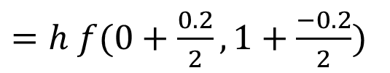

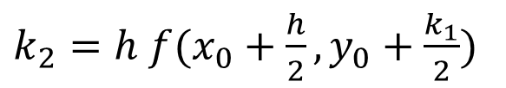
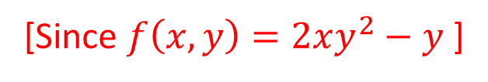
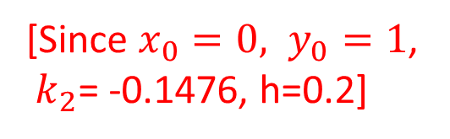


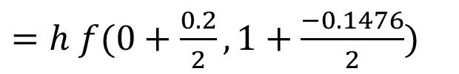
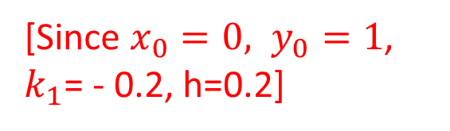
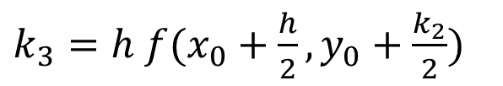

$k_{2}=h f(x_{0}+\frac{h}{2}, y_{0}+\frac{k_{1}}{2})$
$=h f(0+\frac{0.2}{2}, 1+\frac{−0.2}{2})$
[Since $x_{0}=0, y_{0}=1$, $k_{1}$= - 0.2, h=0.2]
$=0.2 f(0.1, 0.9)$
$=0.2 [2\left(0.1\right)\left({0.9)}^{2}−0.9\right]$
[Since $f\left(x,y\right)=2xy^{2}−y$ ]
$$=−0.1476$$
$k_{3}=h f(x_{0}+\frac{h}{2}, y_{0}+\frac{k_{2}}{2})$
$=h f(0+\frac{0.2}{2}, 1+\frac{−0.1476}{2})$
[Since $x_{0}=0, y_{0}=1$,
$k_{2}$= -0.1476, h=0.2]
$=0.2 f(0.1, 0.926)$
$=0.2 [2\left(0.1\right)\left({0.926)}^{2}−0.926\right]$
[Since $f\left(x,y\right)=2xy^{2}−y$ ]
$$=−0.1509$$

Slide 14






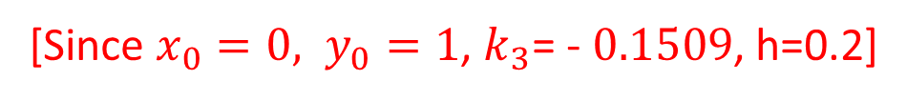
$k_{4}=h f(x_{0}+h, y_{0}+k_{3})$
$=h f(0+0.2, 1−0.1509)$
[Since $x_{0}=0, y_{0}=1$, $k_{3}$= - $0.1509$, h=0.2]
$=h f(0.2, 0.849)$
$=0.2 [2\left(0.2\right)\left({0.849)}^{2}−0.849\right]$
[Since $f\left(x,y\right)=2xy^{2}−y$ ]
$$=−0.1121$$
Therefore,
$y_{1}=y_{0}+\frac{1}{6} [k_{1}+2k_{2}{+2k}_{3}{+k}_{4}]$

Slide 15
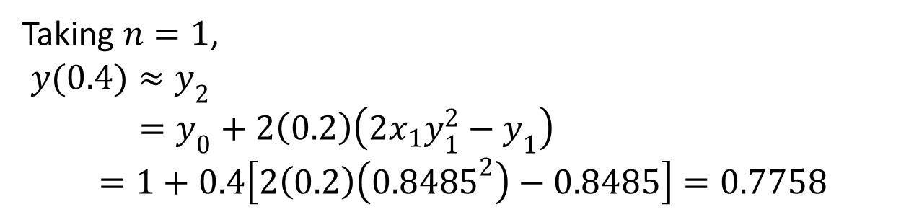
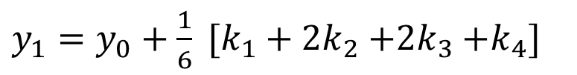



Substituting the values of $y_{0}$, $k_{1}$, $k_{2}$, $k_{3}$ and $k_{4}$ , we get
$y_{1}=y_{0}+\frac{1}{6} [k_{1}+2k_{2}{+2k}_{3}{+k}_{4}]$
$=1+\frac{1}{6} [−0.2+2\left(−0.1476\right)+2(−0.1509)−0.1121]$
$=1+\frac{1}{6} [−0.2−0.2952−0.3018−0.1121]$
$$=0.8485$$
We get, $x_{1}=0.2{, y}_{1}=0.8485$
$$y_{n+1}=y_{n−1}+2h\left(2x_{n}y_{n}^{2}−y_{n}\right)$$
Taking $n=1$,
$${y(0.4)≈y}_{2}=y_{0}+2\left(0.2\right)\left(2x_{1}y_{1}^{2}−y_{1}\right)$$
$$=1+0.4\left[2\left(0.2\right)\left({0.8485}^{2}\right)−0.8485\right]=0.7758$$

Slide 16
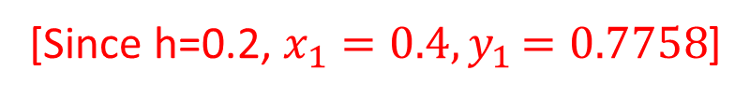
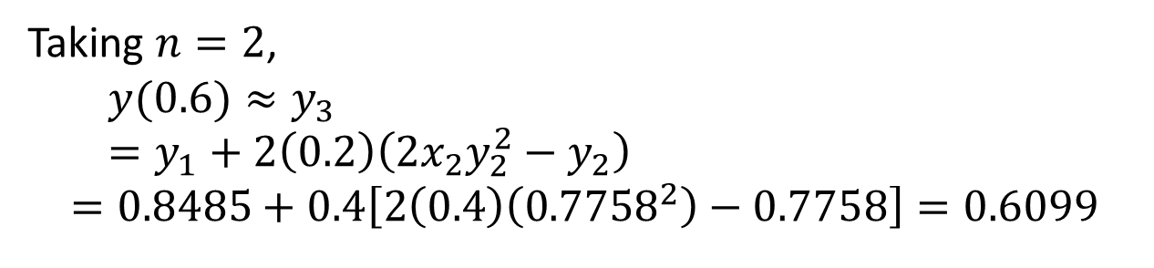

$$y_{n+1}=y_{n−1}+2h\left(2x_{n}y_{n}^{2}−y_{n}\right)$$
Taking $n=2$,
$${y(0.6)≈y}_{3}=y_{1}+2\left(0.2\right)\left(2x_{2}y_{2}^{2}−y_{2}\right)$$
$$=0.8485+0.4\left[2\left(0.4\right)\left({0.7758}^{2}\right)−0.7758\right]=0.6099$$
[Since h=0.2, $x_{1}=0.4{, y}_{1}=0.7758$]
Outcomes
Numerically solved ODE with conditions by using Finite difference method.

Slide 17
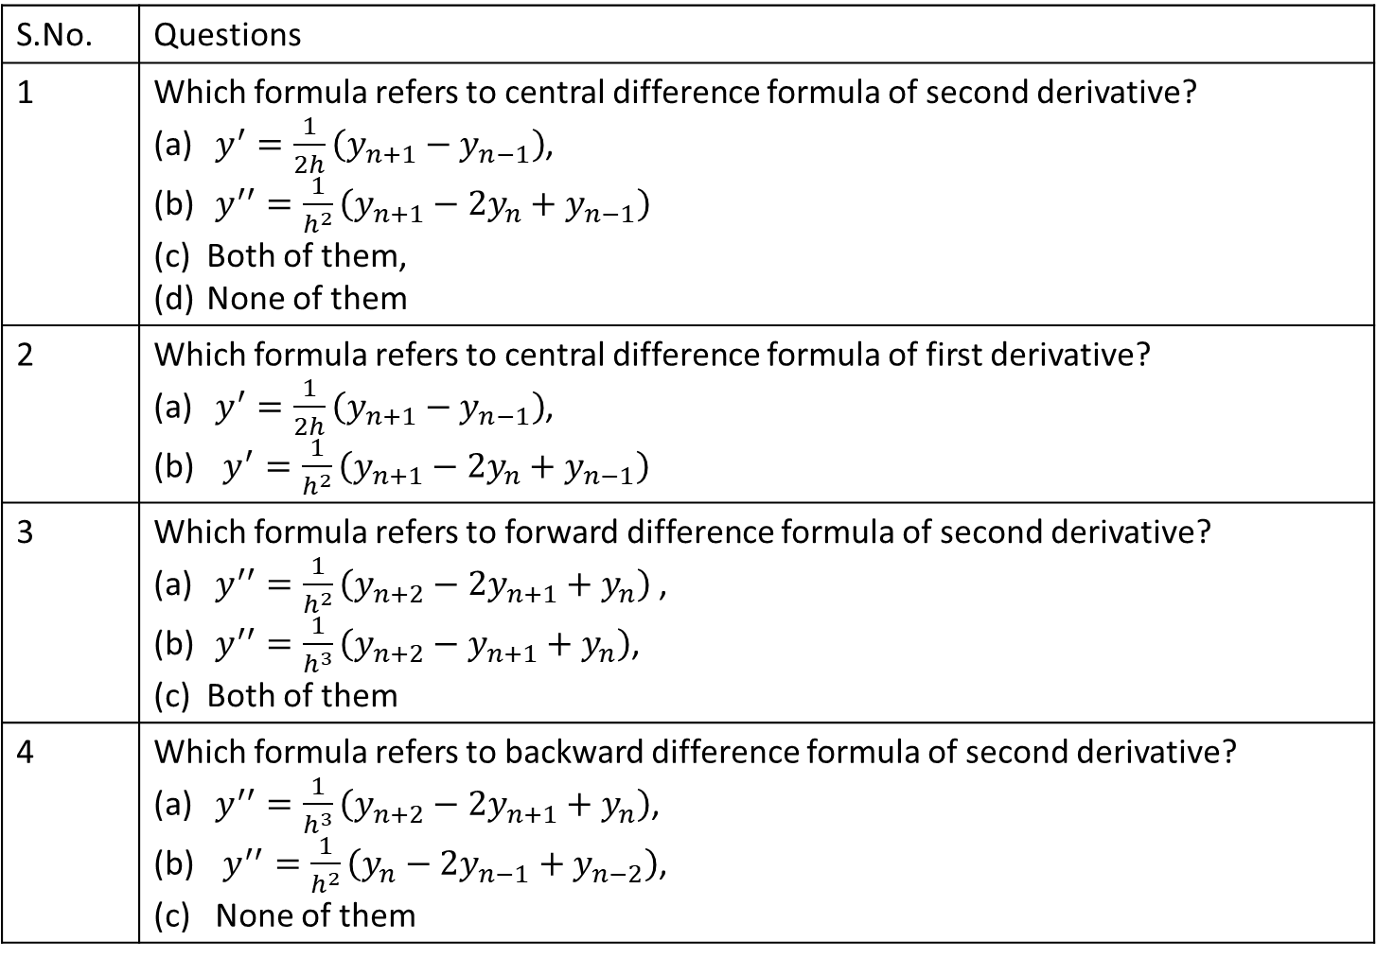
Multiple questions:
S.No. | Questions
1 | Which formula refers to central difference formula of second derivative? $y^{′}=\frac{1}{2h}\left(y_{n+1}−y_{n−1}\right)$, $y^{′′}=\frac{1}{h^{2}}\left(y_{n+1}−2y_{n}+y_{n−1}\right)$ Both of them, None of them
2 | Which formula refers to central difference formula of first derivative? $y^{′}=\frac{1}{2h}\left(y_{n+1}−y_{n−1}\right)$, $y^{′}=\frac{1}{h^{2}}\left(y_{n+1}−2y_{n}+y_{n−1}\right)$
3 | Which formula refers to forward difference formula of second derivative? $y^{′′}=\frac{1}{h^{2}}\left(y_{n+2}−2y_{n+1}+y_{n}\right)$ , $y^{′′}=\frac{1}{h^{3}}\left(y_{n+2}−y_{n+1}+y_{n}\right)$, Both of them
4 | Which formula refers to backward difference formula of second derivative? $y^{′′}=\frac{1}{h^{3}}\left(y_{n+2}−2y_{n+1}+y_{n}\right)$, $y^{′′}=\frac{1}{h^{2}}\left(y_{n}−{2y}_{n−1}+y_{n−2}\right)$, None of them

Slide 18
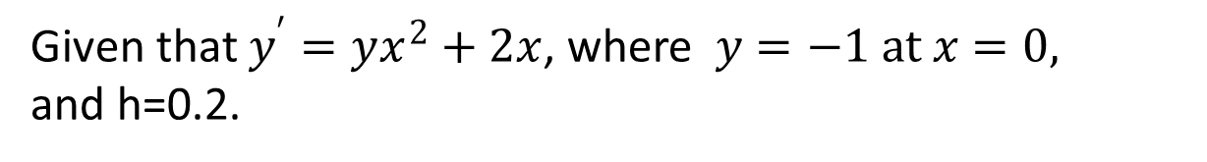
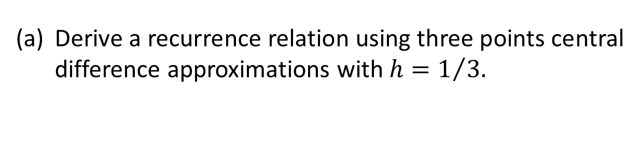
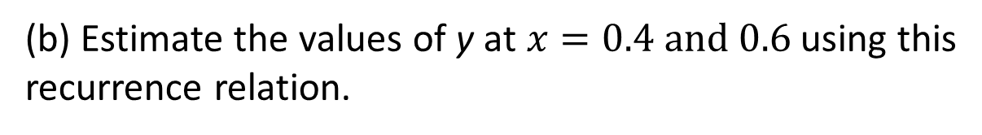
Try to do yourself
Exercise 1:
Consider the boundary value problem
$y^{′′}+5y^{′}+3y=1, y\left(0\right)=1, y\left(1\right)=0$
Derive a recurrence relation using three points central difference approximations with $h=1/{3.}$
(b) Using the above finite difference formula solve the
above BVP.
Exercise 2:
Given that $y^{′}=yx^{2}+2x$, where $y=−1 at x=0,$
and h=0.2.
(a) Use three point central difference formula for derivative to derive a recurrence relation for the above IVP.
(b) Estimate the values of y at $x=0.4 and 0.6$ using this recurrence relation.

